Slide 2
Linux Boot Loaders

Slide 3
Linux Boot Loaders
Overview
A boot loader is a small program that exists in the system and loads the operating system into the system’s memory at system boot. This module deals with two most popular boot loaders of Linux, LILO and GRUB.
Two mainly used:
Lilo Loader
Grand Unified Boot Loader
Notes:
boot loader is a program which is responsible to load the O.S

Slide 4
Lilo Loader
Introduction
LILO or Linux Loader is a boot loader for Linux. A boot loader is a small program that exists in the system and loads the operating system into the system’s memory when the system boots. Boot loader also starts the operating system.

Slide 5
LILO, the Boot Loader
LILO is a flexible boot loader for Linux, which is independent of a file system.
LILO loads itself into the computer’s memory in two stages
Stage1 – This stage, also known as primary boot loader is read into
memory by the BIOS from the master boot record
Stage 2 - This stage, also known as secondary boot loader is read into memory and it displays the Red Hat Linux initial screen
Notes:
LILO stands for linux loader is old boot loader of linux
explain the stages of booting the os

Slide 6
Configuring LILO
To install LILO, it is necessary to know the location of /boot partition.
It is also necessary to know the location of other installed operating systems
LILO can be installed for the first time using a shell script named QuickInst
LILO can be uninstalled using the lilo –u command
Notes:
in case lilo is corrupted , we can reinstall it

Slide 7
Grand Unified Boot Loader
Introduction
Grand Unified Boot loader or GRUB is a boot loader which operates like LILO and it is presently the default boot loader. GRUB sets the user to select the operating system or kernel to be loaded when a system boots up. It also permits the users to pass arguments.
Notes:
GRUB is the default boot loader in new versions of linux

Slide 8
Some of the important features of GRUB
GRUB has the provision of a true command-based, pre-OS environment on x86 machines.
This will help the user in being more flexible in loading operating systems with denoted options or collecting information about the system
GRUB will support Logical Block Addressing (LBA) mode
ext2 partitions can be read by GRUB.
Notes:
Explain the features of GRUB

Slide 9
GRUB Installation and Configuration
GRUB can be installed during installation and also post installation..
GRUB Configuration
When Grub is installed two configuration files are created and they are
/boot/grub/grub.conf is the configuration file of GRUB.
/etc/grub.conf is a link file to /boot/grub/grub.conf and the user can make the configuration changes here
Contd…
Notes:
The main configuration file for GRUB is grub.conf
you can edit this file to set grub password
show demo

Slide 10
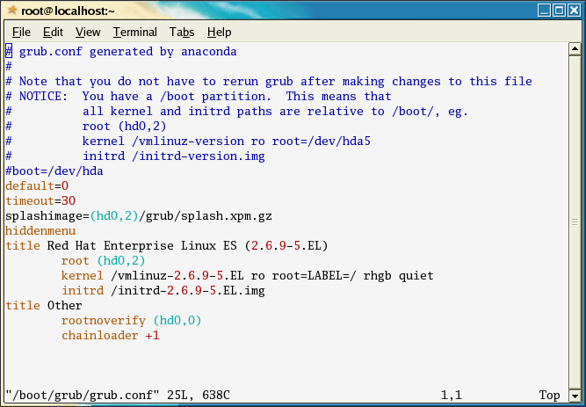
Sample copy of Grub.conf file
Notes:
show demo

Slide 11
Swap Space
Swap space in Linux is used when the amount of physical memory (RAM) is full. If the system needs more memory resources and the RAM is full, inactive pages in memory are moved to the swap space. While swap space can help machines with a small amount of RAM, it should not be considered a replacement for more RAM. Swap space is located on hard drives, which have a slower access time than physical memory.

Slide 12
Swap Space
Swap space can be a dedicated swap partition (recommended), a swap file, or a combination of swap partitions and swap files.
Swap should equal 2x physical RAM for up to 2 GB of physical RAM, and then an additional 1x physical RAM for any amount above 2 GB, but never less than 32 MB.

Slide 13
Example 15.1. Swap RAM
So, if:
M = Amount of RAM in GB, and S = Amount of swap in GB, then
If M < 2
S = M *2
Else
S = M + 2
Using this formula, a system with 2 GB of physical RAM would have 4 GB of swap, while one with 3 GB of physical RAM would have 5 GB of swap. Creating a large swap space partition can be especially helpful if you plan to upgrade your RAM at a later time.
For systems with really large amounts of RAM (more than 32 GB) you can likely get away with a smaller swap partition (around 1x, or less, of physical RAM).

Slide 14
More on Swap space
https://access.redhat.com/documentation/en-US/Red_Hat_Enterprise_Linux/6/html/Storage_Administration_Guide/ch-swapspace.html

